Slide 1
Azure Machine Learning
Matt Witman
Cloud Solution Architect, Advanced Analytics & AI

Slide 2
Our customers have three common objectives
“We want to extend to untapped sources”
“We want to use ML and AI to get deeper insights from our data”
“We want to get insights from our devices in real-time”
Modern Data Warehouse
Advanced Analytics
Real-time Analytics
Notes:
We know what you want to achieve with this, and we’ve got you covered all the way through.
With our customers, we see three common objectives.
“We want to extend to untapped sources”
“We want to use ML and AI to get deeper insights from our data”
“We want to get insights from our devices in real-time”
We have developed reference architectures to help our customers meet each of these objectives:
“We want to extend to untapped sources” -> Modern Data Warehouse
“We want to use ML and AI to get deeper insights from our data” -> Advanced Analytics
“We want to get insights from our devices in real-time” -> Real-time Analytics
You need a solution that can help you prep and train machine learning models with your team for things like recommendation engines, demand forecasting, or predictive maintenance for IoT solutions.
<Transition>: We understand your business objectives, and we have a reference architecture to simplify the implementation of your analytics strategy.

Slide 3
data science & AI
Key trends
challenges
Accelerating adoption of AI by developers (consuming models)
Rise of hybrid training and scoring scenarios
Push scoring/inference to the event (edge, cloud, on-prem)
Some developers moving into deep learning as non-traditional path to DS / AI dev
Growth of diverse hardware arms race across all form factors (CPU / GPU / FPGA / ASIC / device)
Data prep
Model deployment & management
Model lineage & auditing
Explain-ability

Slide 4
The AI Development lifecycle
.
LOB
CRM
INGEST
STORE
PREP & TRAIN
MODEL & SERVE
Graph
On-prem
Cloud
Image
Data orchestration and monitoring
Data lake and storage
Hadoop/Spark/SQL and ML
Social
IoT
Apps + insights
IoT
Cloud
Azure Machine Learning

Slide 5
Machine Learning & AI Portfolio When to use what?
Microsoft ML & AI products
Build your own or consume pre-trained models?
Build your own
Consume
Azure Machine Learning
Cognitive services, bots
Which experience do you want?
Code first
Visual tooling
Deployment target
(On-prem) ML Server
(cloud)
AML services (Preview)
(cloud)
AML Studio
What engine(s) do you want to use?
On-prem Hadoop
SQL Server
SQL Server
Spark
Hadoop
Azure Batch
DSVM
Azure Container Service

Slide 6
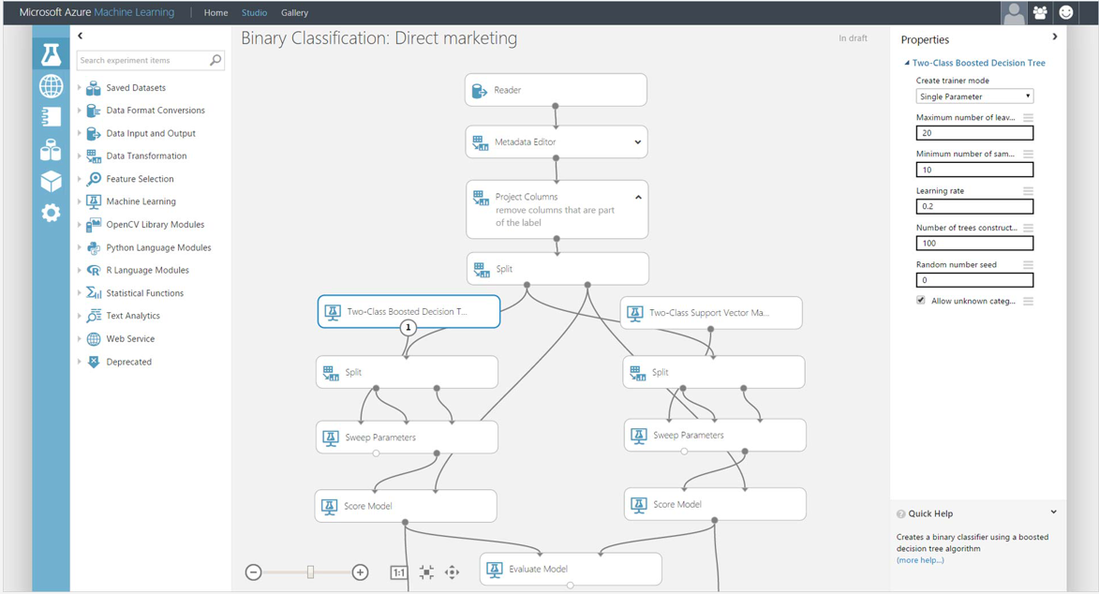
Azure Machine Learning Studio
Platform for emerging data scientists to graphically build and deploy experiments
Rapid experiment composition with >100 easily configured modules for data prep, training, evaluation
Extensibility through R & Python
Serverless training and deployment
Customers love the convenience BUT
Customers have told us they need:
Greater control over compute & data
More options for model deployment
Support for ALL popular frameworks

Slide 7
New Capabilities
AZURE MACHINE LEARNING SERVICES
TRAIN & DEPLOY OPTIONS
Spark
SQL Server
Virtual machines
GPUs
Container services
AZURE
Experimentation and Model Management Services
ON-PREMISES
SQL Server
Machine Learning Server
Azure Machine Learning Workbench
Notebooks & IDEs
VS Code Tools for AI
EDGE
Azure IoT Edge
Notes:
Build, deploy, and manage models at scale
Boost productivity with agile development
Begin building now with the tools and platforms you know

Slide 8

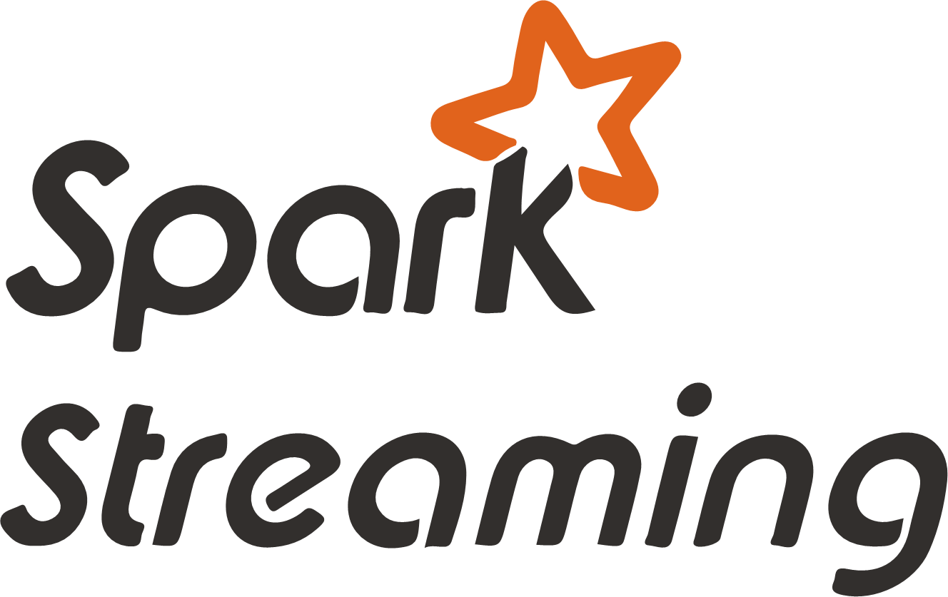
Microsoft has a recommended reference architecture
Ingest
Store
Prep and train
Model and serve
Azure HDinsight
(Apache kafka)
Data science and AI
Azure cosmos DB
Intelligent apps
Streaming data
Azure databricks
Power BI
Data engineering
SQL
Azure SQL data warehouse
Azure analysis services
Batch data
Azure data factory
Azure blob storage
Notes:
Implementing advanced analytics solutions in your organization is a four-step process.
First, you need to ingest data from a variety of data sources, including batch and streaming data.
Azure HDInsight allows you to ingest data at scale in real-time
Azure Data Factory enables you to ingest structured and unstructured batch data at scale, in addition to orchestrating your data preparation processes
Then, you need to take in and store disparate data that’s being ingested regardless of data volumes, variety, and velocity.
With Azure Blob Storage, you can build data integration pipelines that span on-premises and cloud
Next, you need to cleanse, prepare, and train your data.
Azure Databricks enables data scientists and data engineers to collaboratively build and test ML and AI models in the fastest Spark environment
Finally, you need to model and serve this prepared data to your applications, bots, and agents.
Azure Cosmos DB offers low-latency for massively scalable applications
With Azure SQL Data Warehouse, you can easily integrate with leading BI solutions, such as Power BI
<Transition>: Today, we want to focus on preparing and training advanced analytics models.

Slide 9
Prep and train
A
B
C
Collect and prepare data
Train and evaluate model
Operationalize and manage
Azure data factory
Azure ML services
Azure Databricks
Azure Databricks
Azure databricks
Notes:
In order to prep and train advanced analytics models, you first need to collect and prep your data.
Then, you train and evaluate your ML and AI models.
Finally, you need to operationalize, manage, and deploy models into production.
<Transition>: Before we dive deeper into this process, we would like to take a moment to talk about Azure Databricks. As you might be able to guess, Azure Databricks is the linchpin in implementing our recommended advanced analytics architecture.
Additional services in each section:
Collect and prep: Azure Blob Storage
Train and evaluate model: TensorFlow, MS Cognitive Toolkit,
Operationalize and manage: Azure Cosmos DB, Azure SQL Data Warehouse

Slide 10
Collect and prepare all of your data at scale
Azure data factory
Ingest
Azure blob storage
Store
Azure
Databricks
Understand and transform
Connect to data from any source
Leverage best-in-class
analytics capabilities
Scale
without limits
Integrate with all of your data sources
Create hybrid pipelines
Orchestrate in a code-free environment
Leverage open source technologies
Collaborate within teams
Use ML (machine learning) on batch streams
Build in the language of your choice
Leverage scale out topology
Scale compute and storage separately
Notes:
In order to collect and prepare your data at scale, you need to build a data pipeline to ingest, store, and transform your data.
Azure Data Factory enables you to connect to data from any source:
Seamlessly integrate with all your data sources
Create hybrid pipelines
Ingest and orchestrate with a serverless, code-free environment
With Azure Blob Storage, you can store and process data without limits
Process any data, of any size, and at any speed with enterprise-grade security
Scale up or scale out to serve your analytics needs
Scale compute and storage independently, helping you manage TCO
Azure Databricks helps you leverage best-in-class analytics capabilities:
Choose from the best of open source and proprietary technologies
Use machine learning on batch streams to create unified data pipelines
Collaborate within teams to accelerate time-to-insight
<Transition>: Once you have prepared your data, you can train and evaluate machine learning models on your data.
Customer testimonial link: https://customers.microsoft.com/en-us/story/integral-analytics-switches-to-azure-for-high-performance-and-cost-effective-data-warehousing

Slide 11

Train and evaluate Machine Learning models
Tools
Management
Machine learning
Model management
Azure
databricks
Azure ML services
Infrastructure
Scale out clusters
Azure
databricks
Simplify model development
Scale compute resources to meet your needs
Quickly determine the right model for your data
Collaborate in interactive workspaces
Access a library of battle-tested models
Automate job execution
Easily scale up or scale out
Autoscale on a serverless infrastructure
Leverage commodity hardware
Determine the best algorithm
Tune hyperparameters to optimize models
Rapidly prototype in agile environments
Notes:
Training and evaluating machine learning models requires you to build models quickly, scale dynamically, and manage models proactively.
Azure Databricks simplifies model development:
Easily collaborate in interactive workspaces
Leverage a library of battle-tested models
Automate job execution and model version control
Databricks also helps you scale compute resources to meet your advanced analytics needs:
Easily scale up on VMs or scale out on clusters
Autoscale on serverless infrastructure, paying only for what you use in the cloud
Leverage commodity hardware to reduce TCO
Azure Machine Learning Services enables you to quickly determine the right model for your data:
Determine which algorithm is best for your data
Tune hyperparameters to optimize your ML models
Rapidly prototype in agile environments
<Transition>: Once models have been trained and evaluated, you need to operationalize and manage your models.
Customer testimonial link: https://customers.microsoft.com/en-us/story/mercedes-benz-caminhoes-azure-sql-powerbi-cortana-dynamics-consulting-brazil

Slide 12

Operationalize and manage models with ease
Azure databricks
Train and evaluate models
Azure ML services
Model MGMT, experimentation,
and run history
Containers
AKS
ACI
IoT edge
Bring models to life quickly
Proactively manage model performance
Deploy models closer to your data
Build and deploy models in minutes
Iterate quickly on serverless infrastructure
Easily change environments
Identify and promote your best models
Capture model telemetry
Retrain models with APIs
Deploy models anywhere
Scale out to containers
Infuse intelligence into the IoT edge
Notes:
For effective model operationalization, you need to deploy and manage models in many different production environments.
Whether you need to deploy your models to containers, apps, dashboards, or IoT devices, Microsoft has you covered.
Azure Databricks helps you bring models to life quickly:
Take models from inception to production in minutes
Iterate quickly on a serverless infrastructure
Easily change environments for agile experimentation
Azure Machine Learning Services enables you to proactively manage model performance
Identify and promote your best performing models
Capture model telemetry for actionable insights
Retrain models and update deployments with programmable APIs
Deploy models closer to your data using Azure Container Instances and Azure Kubernetes Services:
Scale out to container-based environments
Deploy models to the destination of your choice
Infuse intelligence into the IoT edge
<Transition>: Now let’s take a deeper look at deploying models to devices on the edge.
Customer testimonial link: https://customers.microsoft.com/en-us/story/alaskadotpf-government-azure-iot

Slide 13
Deep learning with Azure
Notes:
<Transition>: Let’s take a look at how Azure enables you to develop and operationalize deep learning models.

Slide 14


Build and deploy deep learning models
Scale out clusters
Azure
databricks
Caffe2
Keras
MS cognitive
toolkit
Notebooks
Azure
databricks
TensorFlow
Scale out clusters
Azure ML Services
Batch AI
Streamline AI development efforts
Scale compute resources in any environment
Quickly evaluate and identify the right model
Leverage popular deep learning toolkits
Develop your language of choice
Choose VMs for your modeling needs
Process video using GPU-based VMs
Run experiments in parallel
Provision resources automatically
Notes:
Just like with machine learning models, training and evaluating Custom AI models requires quick development, dynamic scaling, and effective model management.
Azure Databricks streamlines your AI development efforts:
Build models using popular deep learning toolkits
Develop in the languages and tools of your choice
Databricks also helps you scale compute resources in any environment
Choose VM types based on your modeling requirements
Process images and videos using GPU-based and FPGA-based VMs
Azure Machine Learning Services facilitates effective model management and evaluation:
Save time by running experiments in parallel
Provision and manage resources automatically
Customer testimonial link: https://customers.microsoft.com/en-us/story/mercedes-benz-caminhoes-azure-sql-powerbi-cortana-dynamics-consulting-brazil
<Transition>: Let’s take a closer look at the services and frameworks that make this possible.

Slide 15



Leverage deep learning services and frameworks
Azure databricks
Azure ML services
Accelerate processing with the fastest Spark engine
Bring AI to the edge
Integrate natively with Azure services
Increase your rate of experimentation
Access enterprise-grade Azure security
Deploy and manage your models everywhere
Leverage your favorite deep learning frameworks
TensorFlow
MS Cognitive Toolkit
PyTorch
Scikit-Learn
ONNX
Caffe2
MXNet
Chainer
Notes:
Azure Databricks is a fast, easy, and collaborative Apache Spark-based analytics platform optimized for Azure. Designed in collaboration with the founders of Apache Spark, Azure Databricks combines the best of Spark and Azure to help customers accelerate innovation.
With Azure Databricks, you can:
Accelerate data processing with the fastest Spark engine
Innovate faster, thanks to native integration with services like PBI, Azure SQL DW, Cosmos DB and Blob Storage
Protect your data with enterprise-grade Azure security.
Azure Machine Learning services enables you to:
Bring the power of AI to the IoT edge
Increase your rate of experimentation by rapidly prototyping on your desktop, then easily scaling up on VMs or scaling out on Spark clusters
Deploy models into production faster in the cloud, on-premises, or at the edge
Promote your best performing models into production and retrain them when their performance degrades
These Azure services also empower you to leverage your favorite deep learning frameworks for AI development, including:
TensorFlow
The Microsoft Cognitive Toolkit
PyTorch
Scikit-Learn
ONNX
Caffe2
MXNet
Chainer
<Transition>: Let’s dive into each of these services in a little more detail, starting with Azure Databricks.

Slide 16
Introducing Azure Databricks
Fast, easy, and collaborative Apache Spark™-based analytics platform
Built with your needs in mind
Increase productivity
Role-based access controls
Effortless autoscaling
Build on a secure, trusted cloud
Live collaboration
Enterprise-grade SLAs
Best-in-class notebooks
Scale without limits
Simple job scheduling
Seamlessly integrated with the Azure Portfolio
Notes:
Augment your existing data systems by training and evaluating ML models in Azure Databricks.
With Azure Databricks, you can:
Enhance your teams’ productivity
Get started quickly by launching your new Spark environment with one click
Improve collaboration amongst your analytics team through a unified workspace
Build on the most compliant and trusted cloud
Build with confidence, backed by unmatched support, compliance and SLAs.
Regulate access with fine-grained user permissions to Azure Databricks’ notebooks, clusters, jobs and data.
Scale without limits
Operate at massive scale without limits globally.
<Transition>: Once you have trained and evaluated your machine learning and AI models, you need to operationalize your models.

Slide 17

Azure Machine Learning Services
Bring AI to everyone with an end-to-end, scalable, trusted platform
Built with your needs in mind
Boost your data science productivity
GPU-enabled virtual machines
Low latency predictions at scale
Increase your rate of experimentation
Integration with popular Python IDEs
Role-based access controls
Model versioning
Deploy and manage your models everywhere
Automated model retraining
Seamlessly integrated with the Azure Portfolio
Notes:
Azure Machine Learning Services empower you to bring AI to everyone with an end-to-end, scalable, trusted platform.
Boost your data science productivity with Azure Machine Learning Packages
Python pip-installable extensions for Azure Machine Learning that simplify creating end-to-end pipelines and enable data scientists to build and deploy machine learning and deep learning models with high AI quality and faster time-to-solution for various domains. Now available for Computer Vision, Text Analytics and Time-Series Forecasting.
Experimentation service
Increase your rate of experimentation. Rapidly prototype on your desktop, then easily scale up on virtual machines or scale out using Spark clusters. Proactively manage model performance, identify the best model, and promote it using data-driven insights. Collaborate and share solutions using popular Git repositories.
Model management
Deploy and manage your models everywhere. Use Docker containers to deploy models into production faster in the cloud, on-premises, or at the edge. Promote your best performing models into production and retrain them when their performance degrades.
Azure Machine Learning Workbench integrates with ONNX models.
Downloadable desktop application and command-line interface for Windows and MacOS. Built-in data preparation learns your data preparation steps as you perform them. Project management, run history, and notebook integration bolsters your productivity. Take advantage of the best open source frameworks, including TensorFlow, Cognitive Toolkit, Spark ML, and scikit-learn.
Work with your ONNX models from Visual Studio Code Tools for AI.
Easily convert models from popular toolkits to the ONNX format through WinML tools and programmatically call services to integrate with Azure Machine Learning Services.
Build deep learning models and call services straight from your favorite IDE easier with Azure Machine Learning services built right in. Create a seamless developer experience across desktop, cloud, or at the edge.
AI Toolkit for Azure IoT Edge
Bring the power of artificial intelligence and machine learning to the edge. Package pre-built models such as predictive maintenance, image classification, and speech processing and deploy to IoT gateways or devices with Azure Machine Learning and Azure IoT Edge.
MMLSpark is an open-source Spark package that enables you to quickly create powerful, highly-scalable predictive and analytical models for large image and text datasets by using deep learning and data science tools for Apache Spark.
<Transition>:

